Slide 1
Office 365 development

Slide 2
Deep dive in Office Outlook Add-ins
</>

Slide 3
Agenda
Intro to Mail Add-ins
Contextual activation and rules
Office.js API Outlook
Compose Add-ins
Outlook Add-in vision

Slide 4
Developer vision
USERS
DATA
HTML

Slide 5
1
Intro to Mail Add-ins

Slide 6
What is an Office Add-in?
Intro to Mail Add-ins
Web application loaded inside an Office application
Embedded inline or as task pane within documents, mails, or appointments
Works in Office applications such as Microsoft Outlook
Works in Office Web applications such as OWA
Works in mobile Office clients
Office application extensions using Web technologies
HTML 5 and CSS used to construct user interface
JavaScript and jQuery used to add executable logic and event handlers
Add-in can provided code to read/write content to/from Office documents
Add-in can call web services hosted over Internet or running within local network
Notes:
An App for Office can be seen as a Web page loaded inside an Office Application. In some cases it will appear embedded inline within the document. In other cases it might appear as a task pane or within a message in Outlook. Note that the architecture for Apps for Office has been designed to work in both Office Applications and Office Web Applications.
WEF and Apps for Office allow Office applications to be extended in such as way so that they can leverage Web technologies such as HTML 5 and CSS for rendering user interface as well as JavaScript and jQuery to add behavior. When you write the JavaScript code for an App for Office, you can call REST APIs such as those added to SharePoint 2013 to retrieve and update data from across network.

Slide 7
Add-in capabilities
Intro to Mail Add-ins
Rule-based activation
Add-ins can appear based on regex match
Based on presence of entities (e.g., postal address, meeting suggestion)
Based on presence of attachments
Based on type of item
Extensive JS object model API
Access to core item properties in read and compose
Access to body and attachments
Ability to modify fields and add attachments in compose
Launch native reply and new appointment forms
Ability to set custom properties on items

Slide 8
Intro to Mail Add-ins
Exchange and Outlook.com generate a token
Add-in validates token and maps it to known user id
Single sign on
Token:
{
"aud" : "https://mailhost.contoso.com/IdentityTest.html",
"iss" : "00000002-0000-0ff1-ce00-000000000000@mailhost.contoso.com",
"nbf" : "1331579055",
"exp" : "1331607855",
"appctxsender":"00000002-0000-0ff1-ce00-000000000000@mailhost.context.com",
"isbrowserhostedapp":"true",
"appctx" : {
"msexchuid" : "53e925fa-76ba-45e1-be0f-4ef08b59d389@mailhost.contoso.com",
"version" : "ExIdTok.V1“,
"amurl" : "https://mailhost.contoso.com:443/autodiscover/metadata/json/1"
}
}

Slide 9
Office Add-ins A new way to build extensions for Office
Intro to Mail Add-ins
Contextual mail add-in
Add-in launched contextually from a mail message or appointment
Outlook and Outlook Web Access (OWA)
Task pane add-in
Add-in that runs beside a document/mail with read/write access
Word, Excel, PowerPoint, Project, Outlook
Content add-in
Add-in that runs within a document content with read/write access
Excel, PowerPoint, Access
Add-in command
Command in the Office UI to launch add-in or perform UI-less operation
Outlook and Outlook Web Access (OWA)

Slide 10

Anatomy of an Office Add-in
Intro to Mail Add-ins
Each Office Add-in is based on XML-based manifest
Manifest points to a Web page
Manifest defines the type of the Office Add-in
Manifest defines which Office applications it supports
Manifest defines required capabilities
Office Add-in
Manifest
<XML>
Web
Page
HTML+JS
Office Add-in
Notes:
Every App for Office must be distributed with an XML-based manifest which contains information about the app itself. For example, the app manifest contains an address to a Web page on the Internet which is used to load the app. The app manifest also includes information which indicates which Office applications it supports. The app manifest also defines the required capabilities which represent the set of permissions that the app needs in order to run and complete its work.

Slide 11
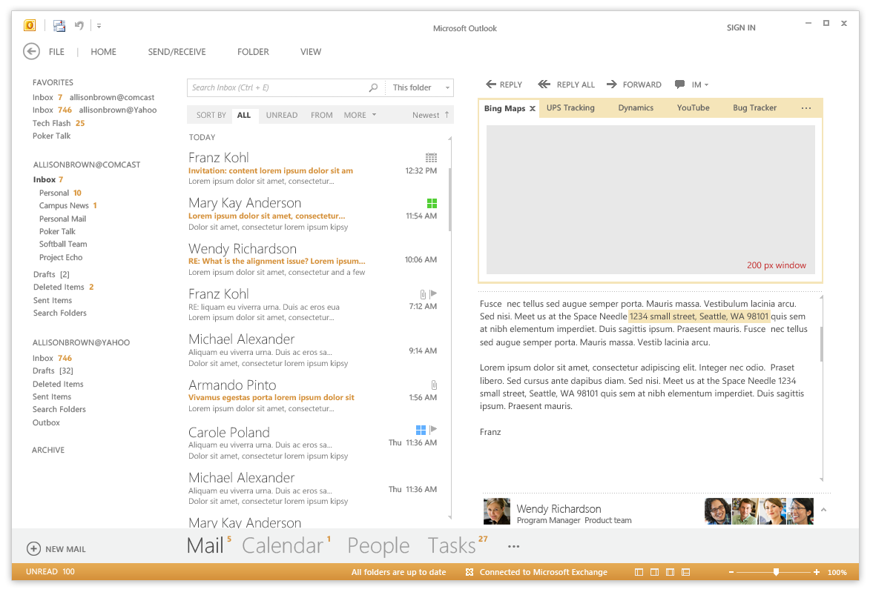
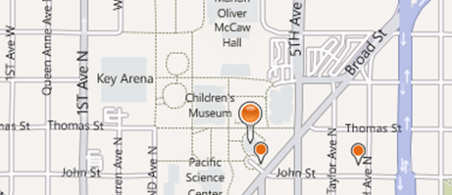
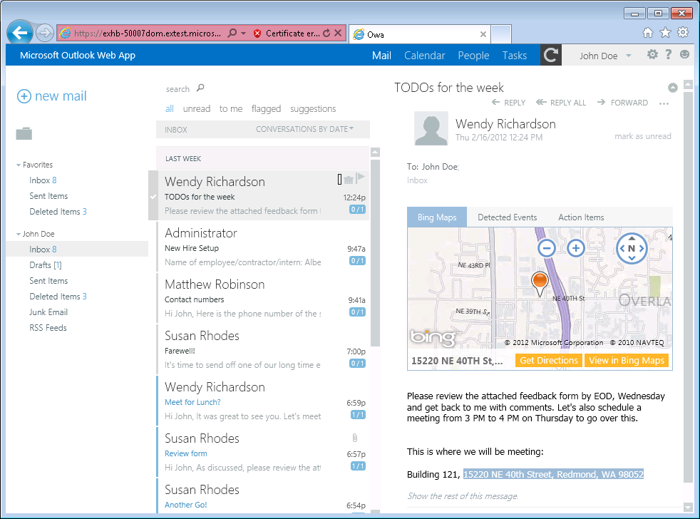
Mail Add-in
Intro to Mail Add-ins
Write once, run anywhere Outlook runs
Same Mail Add-in runs in Outlook, OWA, and Office mobile clients
Development based on activation rules
Activation rules run whenever user selects item
Activated mail add-ins are added into Outlook UI
Designed to be secure
Mail apps run in an isolated, sandboxed process
Mails apps run with a three-tier permission model
Mail Add-ins Require Exchange 2013 or Office 365
Notes:
A key concept of mail apps is that they are written once and can run anywhere Outlook runs including the rich client, the browser and mobile devices. The development model for mail apps based on activation rules. The idea is that activation rules for all installed mail apps run whenever user selects item. All mail apps whose activation rules result in activation are then available to use within the context of that selected item. Furthermore, the experience of app activation and starting a mail app is consistent across Outlook and OWA. When a mail app is started by the user, the mail app is designed to provide the user with contextual information for the selected e-mail message, meeting request, or appointment.
The infrastructure for mail apps has been designed to be secure. With Outlook, mail apps are run in an isolated, sandboxed process. In the browser, mail apps are isolated within their own iFrame. As you will see later in this model, mails apps run with a three-tier permission model which affords a great deal of power in a secure manner.

Slide 12
Mail Add-ins—up close and personal
Intro to Mail Add-ins
Add-in name
Mail Add-in body
Context trigger
Notes:
This slide shows some key aspects of how mail apps integrate into the Outlook and OWA user interface.
When a mail app has activated for a specific Outlook item, its App Name appears in a special App Bar just above the body of the host mail item. A user can start up a mail app by clicking on the App Name in the App Bar. This action results in the mail app loading which will display the Mail App Body. Many activation rules for mail apps are based on finding specific types of content in the host item. For example, the Bing Maps mail app looks for content inside the body that is interested as an address. Such content is considered a Context Trigger and is highlight in the body of the mail item showing the user what specific data the mail app is using to do its work.

Slide 13
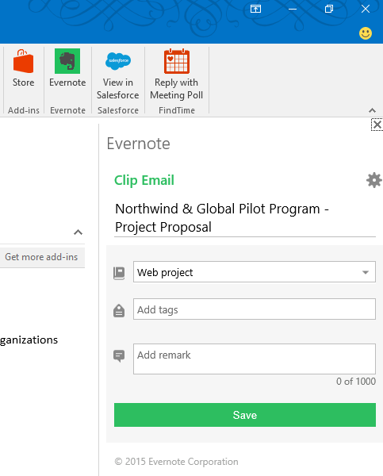
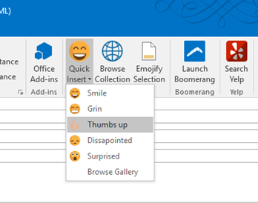
Add-In Commands
Intro to Mail Add-ins
Extend the native command surface with custom buttons and UI
Entry points include Buttons/Menus on the Outlook Ribbon
1-click way for users to take actions
Support backwards
compatibility

Slide 14
Commands UI (Office 2016)
Intro to Mail Add-ins
Scales with the rest of the ribbon
Commands can be on default tab, or create one custom tab
Up to six buttons per group
One group on default tab, up to ten groups on custom tab
Commands that don’t launch UI can show status messages on the mail item or appointment

Slide 15
Add-in commands (Office 2016)
Intro to Mail Add-ins
One-click way for users to take add-in actions
In Outlook desktop, actions are ribbon buttons and can:
Launch task pane
Execute a JavaScript function without showing UI
Dropdown (menu) with different types of buttons as options [coming later]
Support backwards compatibility

Slide 16
Mail Add-in hosting
Intro to Mail Add-ins
Mail Add-ins require Exchange 2013
Exchange Server hosts users mailbox
Exchange Server hosts app manifest files
Web server hosts HTML for Mail Add-in
Mail Add-in can make callback to web server
EWS
Exchange Server
Hosts mailboxes for users
Host Mail Add-in Manifests
Web Server
Hosts HTML, CSS and JavaScript
Notes:
The infrastructure for mails apps require Exchange 2013 and an Exchange Server which hosts users mailboxes. When a mail app is installed, its manifest must be uploaded into the Exchange App Catalog. However, the implementation for a mail app which includes HTML, CSS and JavaScript is not deployed with Exchange but instead on any standard Web server that can serve up HTML pages.
One powerful aspect of developing mail apps is that they can call Exchange Web Services (EWS) which provides the ability to create new email message and appointments and to read other mail items in the current users inbox. Calls to EWS can be made directly from JavaScript behind the mail app itself. However, the mail app can also call back to its hosting Web server passing the required security credentials so that the Web server can call into EWS. This makes it possible to work with server-side code behind a mail app that does its work in C# and VBNET and still has the power to call into EWS.

Slide 17
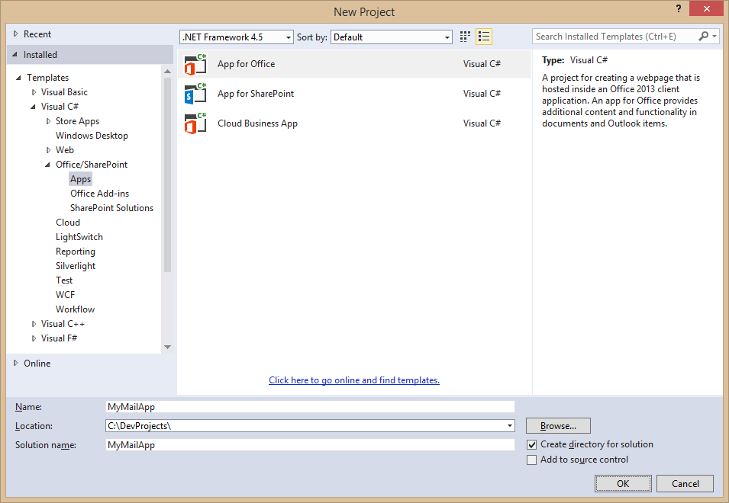
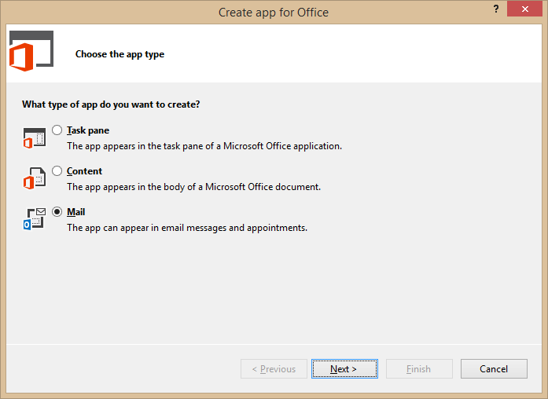
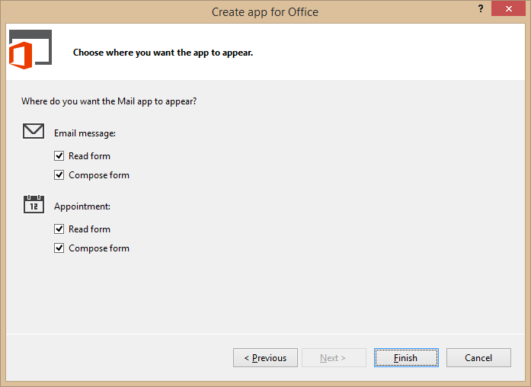
Developing Mail Add-ins
Intro to Mail Add-ins
Use the Visual Studio project template for Mail Add-ins
Notes:
To create mail app, you can use Visual Studio and a new project template dedicated to creating mail apps.

Slide 18
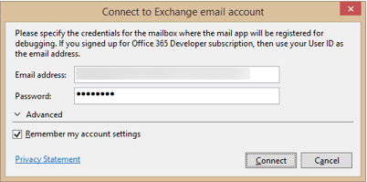
Steps to implementing, testing and debugging
Intro to Mail Add-ins
Specify height from 32 to 350 pixels
Define activation rules
Create UI and style with CSS
Write JavaScript to add behavior and business logic
Debug using Exchange Server and a valid Exchange account
Press {F5} and Visual Studio prompts for server and user mailbox credentials
Notes:
This slide details the high-level steps of creating a mail app. Within the app manifest, you should specify a height for the mail app between 32 pixels to 350 pixels. Note that you cannot specify the width as the mail app will take up all the available width in the host application. Next, you define one or more activation rules. Next, you create the user interface for the mail app using HTML5 and CSS. After that, you write JavaScript to add the required behavior and business logic. When you are finally ready to test your work, you can press the {F5} key to begin the debugging process.
In order to test and debug a mail app, you must have a installed version of Exchange 2013 and a valid Exchange account with a mailbox. When you press the {F5} key for the first time Visual Studio 2012 prompts you with the dialog shown above to track the server running Exchange 2013 as well as the login credentials for the user mailbox used for testing.

Slide 19
Demo Creating and testing a Mail Add-in for Outlook
Intro to Mail Add-ins
Notes:
Build and debug a mail read add-in from scratch in Visual Studio

Slide 20
2
Contextual activation and rules

Slide 21
Rule-based activation
Contextual activation and rules
Mail Add-ins activate based on rules
Rules are defined in the manifest
Rules are applied to the selected item in the Explorer or Inspector
If conditions are met, the Add-in will be activated and available for use
About rules
Multiple rules can be combined for complex activation needs
Apply logical AND or OR operators
Rules can access known entities such as phone numbers
Rules can be defined using regular expressions
Notes:
Every mail app is created with one or more activation rules. These rules are defined in the app manifest using XML. These activation rules are run for each installed mail app whenever the user select a new mail item that is a mail message, and event or an appointment. If the conditions for an activation rule are met, then the mail app is activated and becomes available to start by the user.
A simple mail app can be based on a single activation rule. However, a mail app can contain multiple rules that can be combined for complex activation needs. When you add more than one activation rule, you must decide whether to AND the rules together or to OR the rules together.
Activation rules can be based on known entities such as address and phone numbers. For more specific scenarios, activation rules can also be defined using custom regular expressions.

Slide 22
Activation rule types
Contextual activation and rules
ItemIs
A rule that checks the item type (appointment or message)
<Rule xsi:type=“ItemIs” ItemType=“Message”>
ItemHasKnownEntity
A rule to check if the item has a specific type of known entity
<Rule xsi:type=“ItemHasKnownEntity” EntityType=“Address” />
ItemHasRegularExpressionMatch
Defines a rule using a custom regular expression to match the contents of an item
RuleCollection
Defines a rule composed of multiple rules (combined using AND or OR)
Notes:
There are several different types of activation rules.
The ItemIs rule checks to see whether the item type is a message or an appointment.
<Rule xsi:type=“ItemIs” ItemType=“Message”>
The ItemHasKnownEntity rule checks to see if the item has a specific type of known entity
<Rule xsi:type=“ItemHasKnownEntity” EntityType=“Address” />
The ItemHasRegularExpressionMatch rule checks to see if an item has content that matches custom regular expression.
The RuleCollection rule combines two or more inner rules using either the AND operator or the OR operator. When using the AND operator, all inner rules must be met for activation to occur. When using the OR operator, only one inner rule must be met for activation to occur.

Slide 23
Contextual activation and rules
Well-known entity examples
Entity type | Recognition condition
Address | United States street addresses 1 Microsoft Way, Redmond, WA 07722
EmailAddress | Any SMTP email address
MeetingSuggestion | A reference to an event or meeting Let’s meet next Tuesday for lunch.
Contact | A personal name related to other entities Steve Ballmer, Microsoft, 1 Microsoft Way, Redmond, WA 07722
PhoneNumber | United States telephone numbers (507) 555-1212
TaskSuggestion | Actionable sentences in an email Please install Office 2013 on my computer
Url | A file name or web address
Outlook is aware of specific types of entities
Items are parsed and scanned for common types of entities
Use ItemHasKnownEntity rules to based activation rules on entities
Within add-in use API functions getEntities or getEntitiesByType
Notes:
Outlook 2013 is aware of several specific well-known types of entities which are listed in the table on the slide above. When you create an activation rule based on one of these entities, Outlook will parse and scan the current item for the presence of content that matches that type of entity.
To create an activation rule based on a well-known entity with XML inside the app manifest, you use the ItemHasKnownEntity rule
<Rule xsi:type=“ItemHasKnownEntity” EntityType=“Address” />
When you are writing JavaScript code for the mail app, you will need to retrieve the entity value which can be done using the API functions getEntities or getEntitiesByType.

Slide 24
3
Office.js API

Slide 25

Accessing the Office.js API for Outlook
Offfice.js API
Outlook Add-in API available through mailbox
Office
context
Message
mailbox
Message compose
Item can be cast to one of four different types
item
Appointment
Appointment compose
Notes:
Access to the Outlook JavaScript Object Model (JSOM) is available through the Office.context.mailbox object. From here you can obtain access to information about the selected mail item and user profiles for the current user as well as other users such as the one that sent the message.

Slide 26
Demo Programming an Add-in for Outlook using Javascript
Offfice.js API
Notes:
Go back to the original demo and show the scripts that leverage Office.js

Slide 27
4
Compose Add-ins

Slide 28

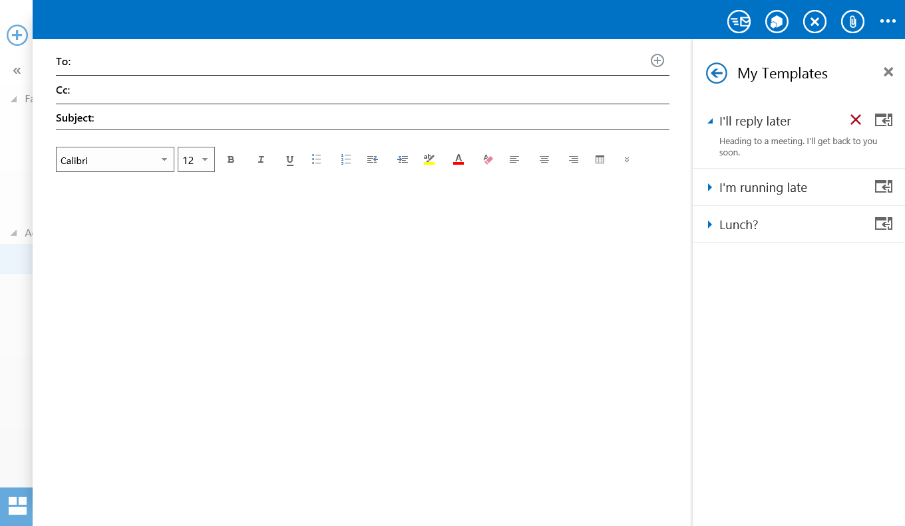
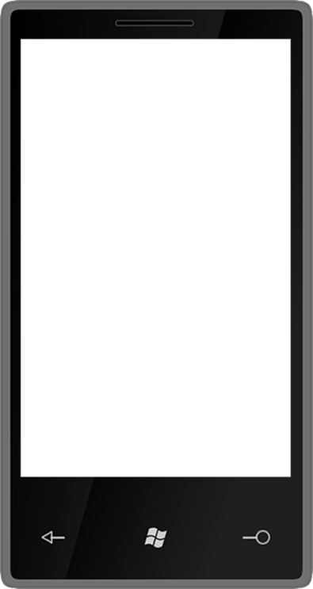
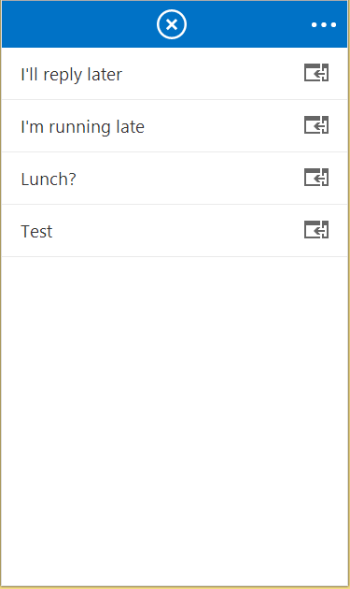
Compose Add-ins activation
Compose Add-ins
Add-ins can appear in messages and/or appointments
Compose add-ins are across desktop, tablet, and mobile

Slide 29
Compose Mail Add-ins capabilities
User identity token
O365 API requests
Settings
User profile
Compose Add-ins
Use core JS APIs
Read/write recipients
Read/write subject
Add attachments
Write to the body
R/W appointment properties
Custom item properties

Slide 30
Compose Mail Add-ins capabilities
Get/set/add recipients or attendees
Get/set the subject
Compose Add-ins
Use core JS APIs
Read/write recipients
Read/write subject
Add attachments
Write to the body
R/W appointment properties
Custom item properties

Slide 31
Compose Mail Add-ins capabilities
Add file or item attachments
Add file or item attachments
Compose Add-ins
Use core JS APIs
Read/write recipients
Read/write subject
Add attachments
Write to the body
R/W appointment properties
Custom item properties

Slide 32
Compose Mail Add-ins capabilities
Prepend to the body
Overwrite current selection in body
Compose Add-ins
Use core JS APIs
Read/write recipients
Read/write subject
Add attachments
Write to the body
R/W appointment properties
Custom item properties

Slide 33
Compose Mail Add-ins capabilities
Get/set start or end time
Get/set location
Get/set/add attendees
Compose Add-ins
Use core JS APIs
Read/write recipients
Read/write subject
Add attachments
Write to the body
R/W appointment properties
Custom item properties

Slide 34
Compose Mail Add-ins capabilities
Saved on the sent item
Can be used to mark a composed message (e.g., “tracked” in CRM)
Compose Add-ins
Use core JS APIs
Read/write recipients
Read/write subject
Add attachments
Write to the body
R/W appointment properties
Custom item properties

Slide 35
Demo Creating a translation compose Mail Add-in
Compose Add-ins
Notes:
Create a simple compose mail add-in

Slide 36
5
Outlook Add-in vision

Slide 37
Outlook Add-in vision
Outlook Add-in vision
Add-ins must feel native and intuitive
Leverage UI framework of host client
Entry points must scale gracefully
Write once, run everywhere

Slide 38
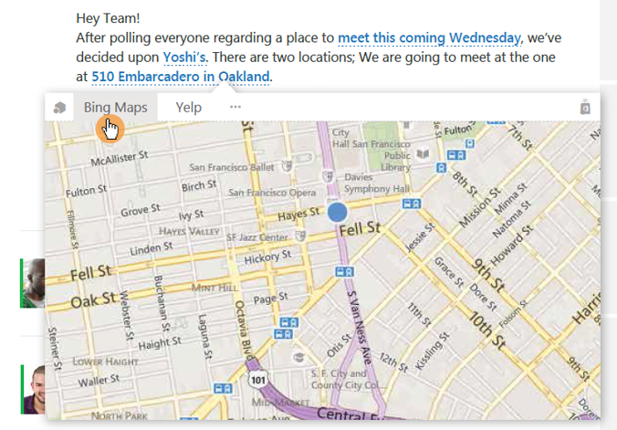
Body text highlighting
Outlook Add-in vision
Outlook will highlight regex matches and entities against plain text body
Clicked on entity or regex match will be passed into add-in
Add-in is loaded in a hover card experience

Slide 39
Outlook Add-in Commands Roadmap
Shipped!
Jan 2016
Q1CY2016
Outlook 2016
Outlook 2013 In-client store (coming first to Outlook 2016)
Outlook Online (OWA) Outlook.com
Word/Excel/PPT 2016 & Online

Slide 40
Demo Add-in commands
Outlook Add-in vision
Notes:
Boomerang
Command DEMO https://github.com/jasonjoh/command-demo

Slide 41
Summary
Intro to Mail Add-ins
Contextual activation and rules
Office.js API Outlook
Compose Add-ins
Outlook Add-in vision

Slide 42
Further reading…
Getting Started with Office add-ins
Office add-in Code Samples
Office add-in Training videos & hands on labs
Office add-in Snack videos
Office add-in documentation

Slide 43
Developer Program launch
1 YEAR FREE
Email Newsletters
Free Developer Subscription
Free Training
Free Tools
Webinars
http://dev.office.com/devprogram

Slide 44
Engage

